Slide 1
Final Review
Group 11
Fahad
Haroon Kabeer
Mohammed Riyas
Paul Thomas Nettikadan
Guide - Mr Jinesh K J

Slide 2
Design And Development of Remote Rehabilitation Glove

Slide 3
Contents
Introduction
Objectives
Literature Review
Methodology
Budget
Conclusion
References

Slide 4
Introduction
Many people who have a stroke are left with problems with one of their arms. Stroke often causes paralysis or weakness of one or more of the muscles in your arm or shoulder.
Hand rehabilitation is core to helping stroke survivors regain activities of daily living.
There is an increasing interest in robotic gloves to optimize hand and finger related functional abilities following a neurological event.[1]

Slide 5
Some requirements of hand exoskeletons for rehabilitation are safety, comfort, effective force transmission and portability.[2]
Through this project we aims to create a rehabilitation glove.
It would be lightweight, less bulky and more efficient.
It would have the control mechanism to be operated by experts.
It will also be able to receive feedback from patients.

Slide 6
Objective
This project aims to design and develop a wearable and adaptive glove for patients that can be remotely controlled by a physiotherapist with a feedback from the patient side.
This includes design and development of three elements:
Exoskeleton
To select suitable materials for exoskeleton to minimise weight.
To design exoskeleton compactly in order to reduce bulkiness
To study finger movements and provide constraints to mimic them into the exoskeleton

Slide 7
Actuation
To select actuators according to design requirements
To select suitable linkages
To select power supply
Control and Feedback
Design and development of control method
Identification and selection of feedback sensors and mechanisms

Slide 8
Literature Review
1."Improving Grasp Function After Spinal Cord Injury With a Soft Robotic Glove,"C. Correia et al., in IEEE Transactions on Neural Systems and Rehabilitation Engineering, vol. 28, June 2020[3]
Demonstrates capability and effectiveness of exoskeletal gloves for the purpose of rehabilitation
Provides the basic requirements in the design of rehabilitation gloves
Hand movements are mimicked to provide effective rehabilitation

Slide 9
2."Ring-pull Type Soft Wearable Robotic Glove for Hand Strength Assistance,"J. Yang, D. Kim, J. Yoon, J. Kim and D. Yun in IEEE Robotics and Automation Letters, vol. 7, Oct. 2022[4]
Propose design for new ring pull mechanism
Overcome disadvantage of existing wearable robotic gloves such as reducing bulkiness and making it lightweight
Single polymer silicon body
Driven by tendon driven actuators
Simple structure and fast response time

Slide 10
3."Design of a wearable hand rehabilitation system for quantitative evaluation of the stroke hand,"J. Lee, W. Park, S. Kim and J. Bae , 16th International Conference on Control, Automation and Systems (ICCAS), 2016[5]
Hand function and performance
Finger Stiffness,finger independency ,multi finger synergy quantitatively,finger joint angles etc
Voluntary motion such as hand extension and hand flexing
Wearability,durability,soft contacting

Slide 11
Paper | Advantages | Disadvantages
1 | Demonstrates the effectiveness of exoskeletons in rehabilitation | Lacks portability Physical presence of expert required
2 | Lightweight and Compact More efficient actuating mechanism | Strength assistance to on two fingers Retraction not possible Feedback not available
3 | Feedback Mechanisms and sensors are provided Wearable and durable | Bulky and heavy Controls are preprogrammed

Slide 12
Methodology
DESIGN
EXOSKELETON
Compact and flexible design
Lightweight
Designed to mimic normal finger movements

Slide 13
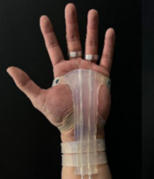
ACTUATION AND LINKAGE
Ring pull type actuating mechanism
Tendon linkages should be used
The maximum pulling force of the finger from the knuckle is 109.7N(10.97Kg)[4]

Slide 14
Motor chosen is in accordance with its stall torque (10 kg.cm)
Rotating pulleys are used for extension and retraction of tendons
Microcontroller is used for the control of the system

Slide 15
COMPONENTS
Lithium polymer battery
6200 mah, 7.4v
N20 Micro Metal gear encoder
Rated voltage DC 6V
Output speed 30 RPM
Rated current 45mAh
Rated speed 25RPM
Stall current 1A
Stall torque 10kg-cm

Slide 16
Arduino Nano RP2040
133 MHz 32 bit dual core arm cortex-M0+ processor
520 KB on chip SRAM
U-Blox nina W102 Wifi/Bluetooth module
Glove
The exoskeleton is made from silicon polymer
Silicon has a tensile strength of 170 MPa
Tendon
The tendon used is kevlar thread of size 69 which has a breaking
strength of 23 pounds (10.43 kg)
The pulling force of the finger from the knuckle is 109.7N

Slide 17
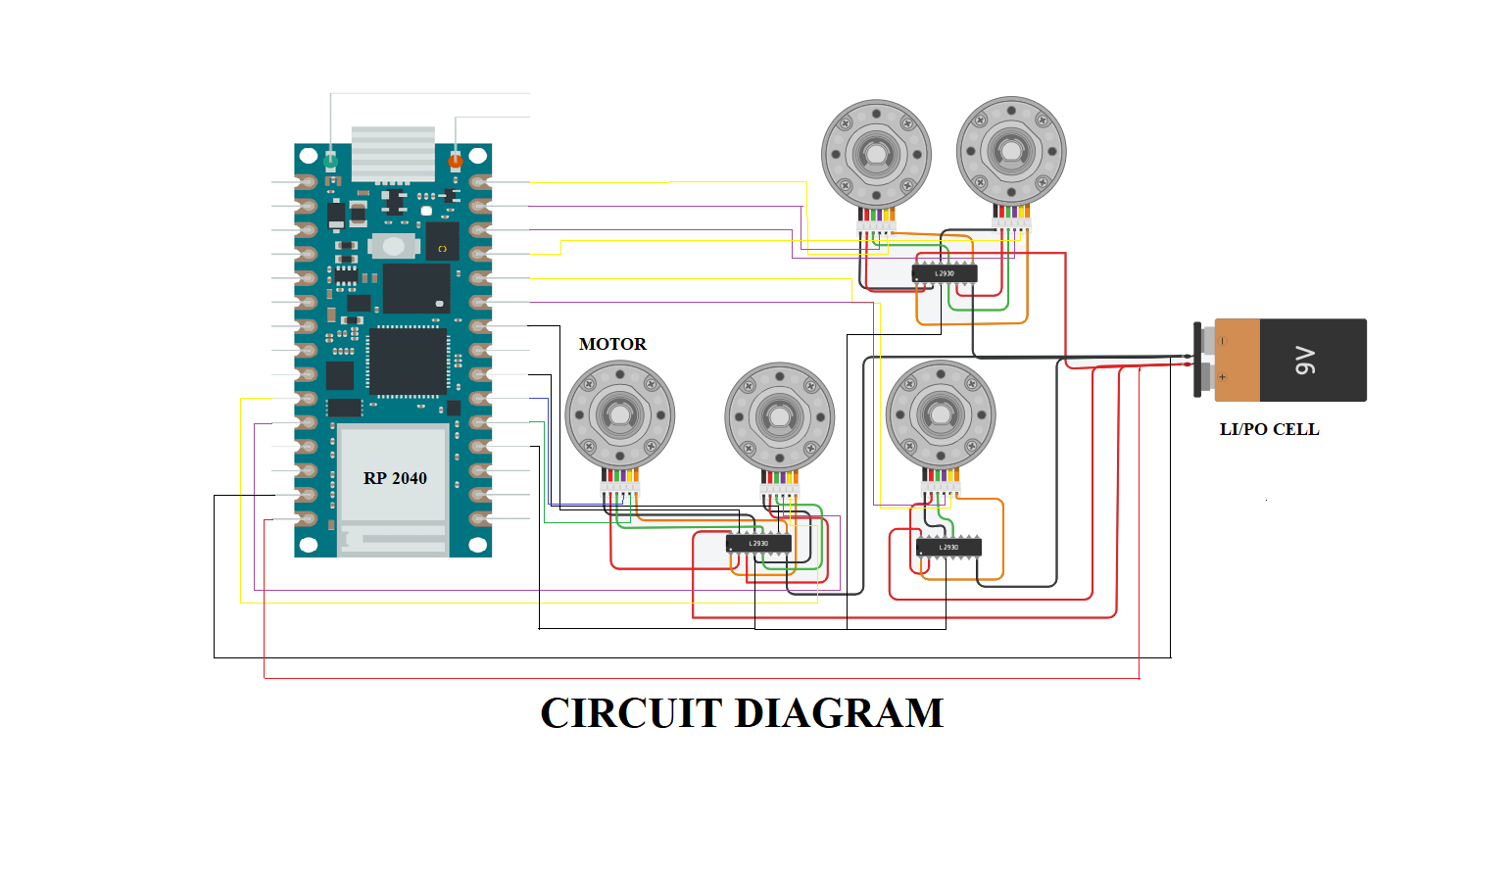
CIRCUIT DIAGRAM

Slide 18
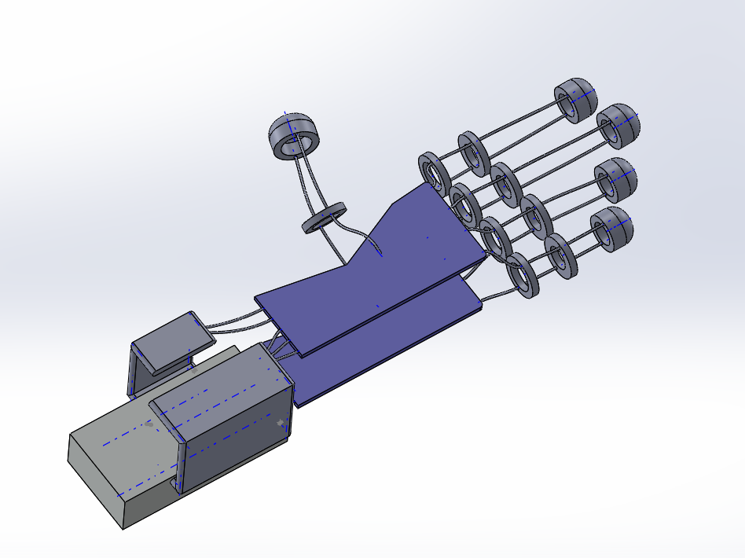
3D DESIGN(Dorsal view)

Slide 19
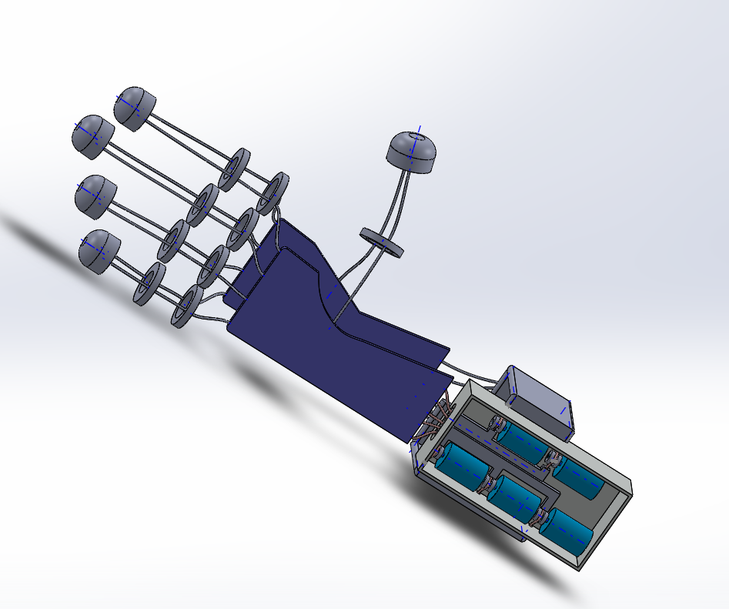
3D DESIGN(Palmar view)

Slide 20
Budget
Exoskeleton : 4000
Tendon Linkages : 1000
Actuators : 5000
MicroController and associated circuit : 2500
Power Supply : 1000
Motor Driver : 1000
Pulleys, Driver box : 4000
Feedback Sensors : 2000
Total : 20500 Rs

Slide 21
Conclusion
The glove will be lightweight & compact than conventional robotic gloves.
The silicon glove makes it more comfortable to wear and can be fitted with various hand sizes.
The tendon linkage actuators make this more efficient.
The glove will be controlled by an expert.
The feedback on the hand movement will be communicated to the expert.

Slide 22
References
“Robotics in neuro-rehabilitation,” J. Rehabil. Med., vol. 41,L. Pignolo , 2009
"Design Requirements of Generic Hand Exoskeletons and Survey of Hand Exoskeletons for Rehabilitation, Assistive, or Haptic Use," M. Sarac, M. Solazzi and A. Frisoli, in IEEE Transactions on Haptics, vol. 12, Dec. 2019
"Improving Grasp Function After Spinal Cord Injury With a Soft Robotic Glove,"C. Correia et al., in IEEE Transactions on Neural Systems and Rehabilitation Engineering, vol. 28, June 2020
"Ring-pull Type Soft Wearable Robotic Glove for Hand Strength Assistance,"J. Yang, D. Kim, J. Yoon, J. Kim and D. Yun in IEEE Robotics and Automation Letters, vol. 7, Oct. 2022
"Design of a wearable hand rehabilitation system for quantitative evaluation of the stroke hand,"J. Lee, W. Park, S. Kim and J. Bae , 16th International Conference on Control, Automation and Systems (ICCAS), 2016

Slide 23
THANKS!

